Slide 1
JSS ACADEMY OF TECHNICAL EDUCATION
PROJECT BY: MANAV TYAGI (2000910130061)

Slide 2
INDEX
Serial no. | Topic | Slide No.
1 | Introduction(HTML) | 3-4
2 | CSS | 5
3 | JAVA SCRIPT | 6-7
4 5 | CONCLUSION/ CLONE SPOTIFY CLONE APP CERTIFICATE OF INTERNSHIP | 8 9

Slide 3
MINIPROJECT SPOTIFY CLONE USING HTML,CSS AND JAVA SCRIPT.
HTML: The full form of HTML is Hypertext Markup Language. HTML is a standard mark – up language that used build files that are showcased as a web page throughout the browsers. With CSS (Cascading Style Sheet) and JS (JavaScript) inside it, this language becomes more engaging and appealing.
FEATURES OF HTML:
HTML is the most straightforward language. This language is straightforward to understand, & simple to configure.
The language is so versatile that you really can build whatever you want, including the text, a creative way to construct web pages together.

Slide 4
It can render linkable text, as users could connect through these features from one page to other or website.
Users can add images, pictures, gifs or sound whatever they want to make the site more appealing and understandable.
Such language can be used to view the files on any device such as Linux, Windows or Mac.

Slide 5
CSS
The full form of CSS is Cascading Style Sheets. It explains how to show HTML elements on display. For web designers, it is a powerful tool to adjust the design & control of web pages to demonstrate how they should be viewed. It is enabled by browsers and is specifically designed to distinguish the content of the document from the appearance of the report.
Features of CSS
In CSS, a global style sheet could be used such that with no trouble and taking fewer space users can perform any improvements in the style.
One external style sheet can be produced and can be used for designing several websites.

Slide 6
JAVA SCRIPT
JS stands for JavaScript. It is a text-based, lightweight, cross-platform, and interpreted scripting programming language. This language is very popular for developing web pages. It can be used both on the client-side and server-side. Basically, this scripting language not only helps in developing the web pages but also makes the web pages more interactive and attractive to engage the use
ADVANTAGE OF JAVA SCRIPT:JavaScript is executed on the client environment to save lots of bandwidth and make the execution process fast.
It can support all the latest browsers and provide an equivalent result.

Slide 7
JavaScript is very fast because it is usually run quickly within the client’s browser.
When it comes to popularity, Javascript is unbeatable. You will find it everywhere on the web and after the arrival of Node.js, coders have started using it on the backend also.
It provides rich interfaces, so you can use it to add some interesting features on the web page like drag and drop, sliders, and more.
JavaScript can be included in any web page, unlike other scripting languages.

Slide 8
SPOTIFY CLONE APP
By using all these tools as mention before, a clone app is prepared which is SPOTIFY CLONE APP . The main purpose of this app is to provide a platform to the user from where they can listen to the music with more ease and in feasible manner. You can play pause or listen to the music anytime from this clone app.
It is user friendly interface , a person can easily find the songs of his choice and play and enjoy it .
The app works similar to spotify but in a more and convenient way , which gives user more friendly and easy to user interface.

Slide 9
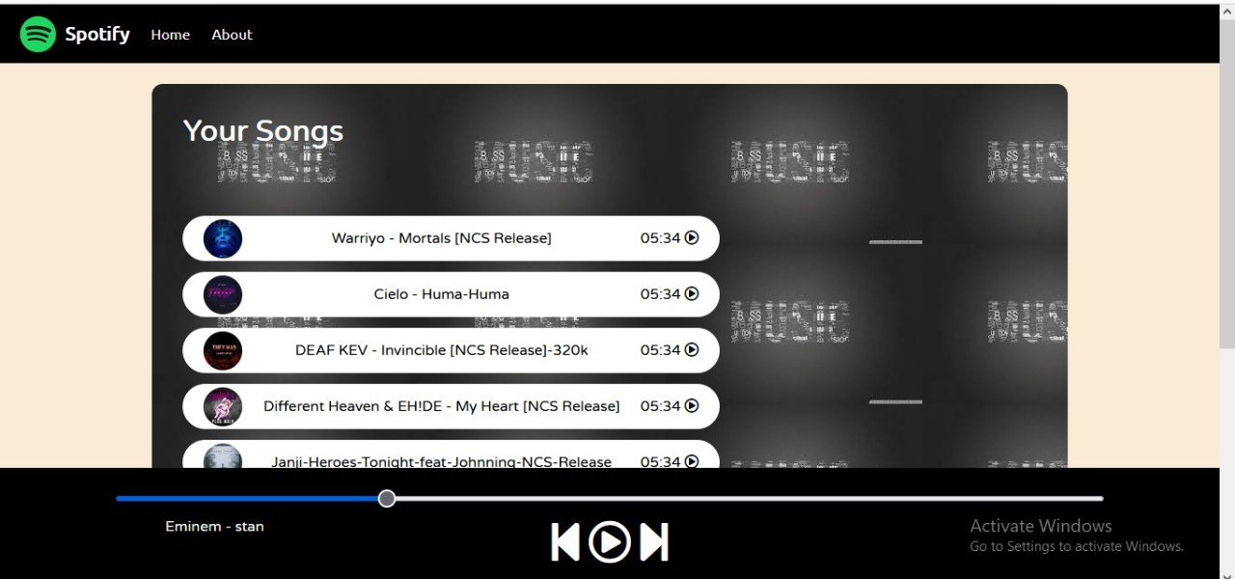

Slide 10
CONCLUSION
By using HTML , CSS AND JS . The music listening website is made
By performing the mini project helped me in being familiar with graphic design principles that relate to web design and learn how to implement theories into practice. Develop skills in analyzing the usability of a web site. Understand how to plan and conduct user research related to web usability.

Slide 11
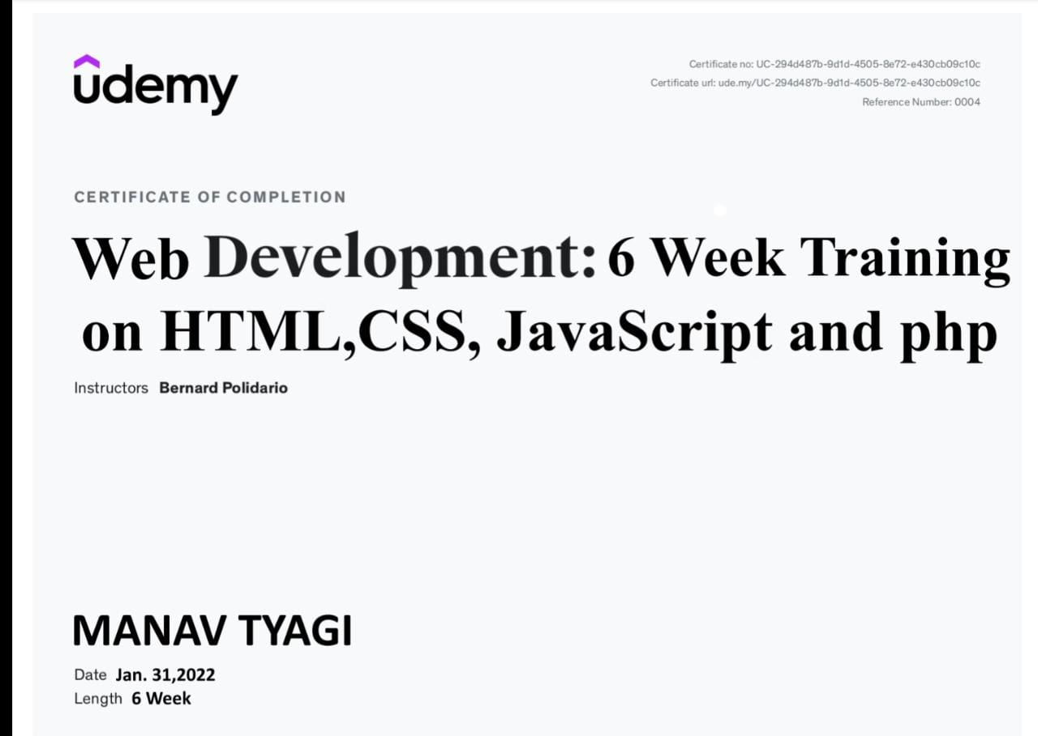

Slide 12
THANK YOU
BY: MANAV TYAGI

